Slide 1

Salesforce AnswerForce
Yugandhar Challa

Slide 2
Contents
Data
Exploratory Data Analysis
Predictive Modeling
Recommendations

Slide 3

Data
8000 Customers
Type of Businesses :
1. ENT
2. SMB
Chat Bot
Number of Clicks (Weekly)
Paid Customer

Slide 4
Type of Businesses
ENT | SMB
3135 | 4865
39.18% | 60.81%

Slide 5
Chat Bot
 | YES | NO | TOTAL
Number of Customers | 4384 | 3616 | 8000
Percentage | 54.8 | 45.2

Slide 6
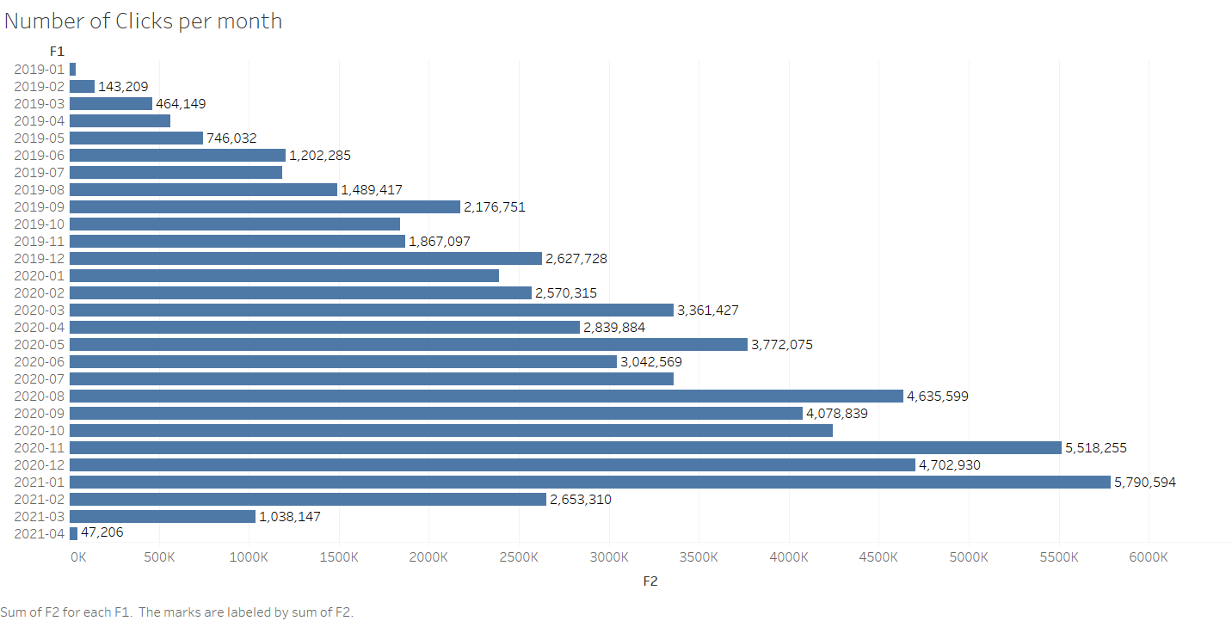
Link Clicks

Slide 7
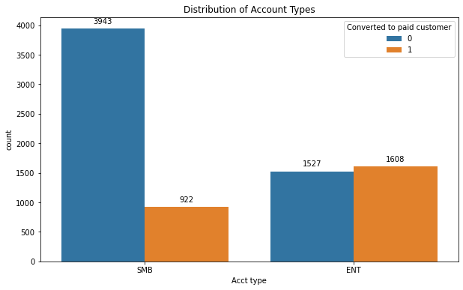
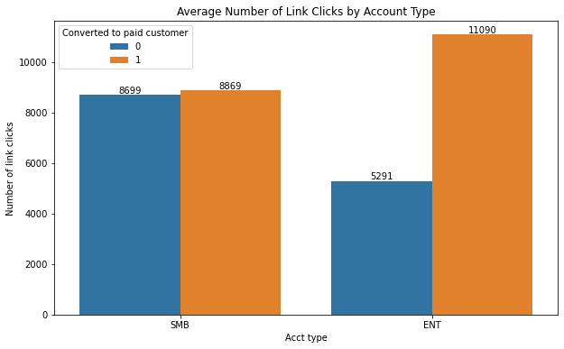
Distribution of Data

Slide 8
Paid Customer
Yes | NO
2530 | 5470
31.625 | 68.375
Overall Conversion Rate: 31.62%
Conversion Rate by Account Type: ENT 51.291866% SMB 18.951696 %
Conversion Rate Number of Customers with Chat Bot Activation
ENT 62.456140%
SMB 49.866393%

Slide 9
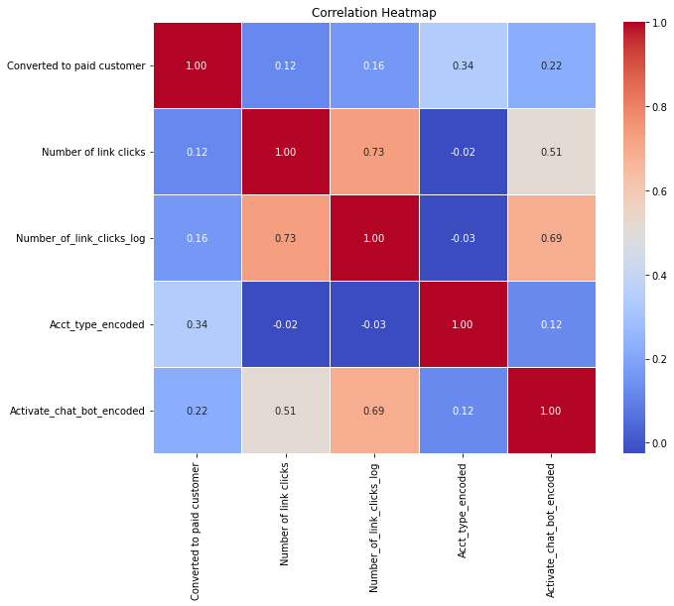
Correlation

Slide 10
Modeling
Classification Models:
Logistic Regression
Decision Tree
Random Forest
SVM
K-NN

Slide 11
Model Results
Model | Accuracy | Precision | Confusion Matrix | AUC-ROC
Logistic Regression | 71.99% | 65.79% | [5157 313 1928 602] | 59.04%
Decision Trees | 67.41% | 48.39% | [4235 1235 1372 1158] | 61.6%
SVM | 68.36% | 33.33% | [5468 2 2529 1] | 50.00%
Random Forest | 67.51% | 48.59% | [4215 1255 1344 1186] | 61.97%
K-NN | 62.92% | 36.82% | [4425 1045 1921 609] | 52.48%

Slide 12
Fine-tuning model
Issues with current data:
Data is not normalized
Account type and converted chatbot features are Categorical
Transformations applied:
Normalized the Number of clicks
Encoded the Account type and converted chatbot features into numerical data

Slide 13
Model Results
Model | Accuracy | Precision | Confusion Matrix | AUC-ROC
Logistic Regression | 77.65% | 68.95% | [4862 608 1180 1350] | 71.12%
Decision Trees | 67.5% | 48.54% | [4238 1232 1368 1162] | 61.7%
SVM | 76.52% | 65.61% | [4752 718 1160 1370] | 70.51%
Random Forest | 67.50% | 48.57% | [4215 1255 1345 1185] | 61.95%
K-NN | 74.3% | 62.18% | [4734 736 1320 1210] | 67.19%

Slide 14
About Trail Program
How is the AnswerForce trial program doing?

Slide 15
About Trail Program
Is there anything they can do to improve the AnswerForce trial program?
Ways to increase the Conversion rate in SMB
Promotional offers for second-time subscription
User Feedback

Slide 16
About Trail Program
Which customers are most likely to convert to paid customers? How do we identify the potential customers who are most likely to convert?
ENT Businesses will be more likely to convert to paid customers
Businesses activated Chat Bot likely to convert to paid customers
Logistic Regression

Slide 17
Thank You

